Slide 1
How to develop a presentation portfolio in Foliotek

Slide 2
Log onto Foliotek By default, you will start on the Assessment screen (white background)

Slide 3
Click on ‘Presentation’

Slide 4
This menu will drop down

Slide 5
Feel free to explore the tabs here Eventually, you’ll select either ‘ePortfolios’ or ‘Dashboard’

Slide 6
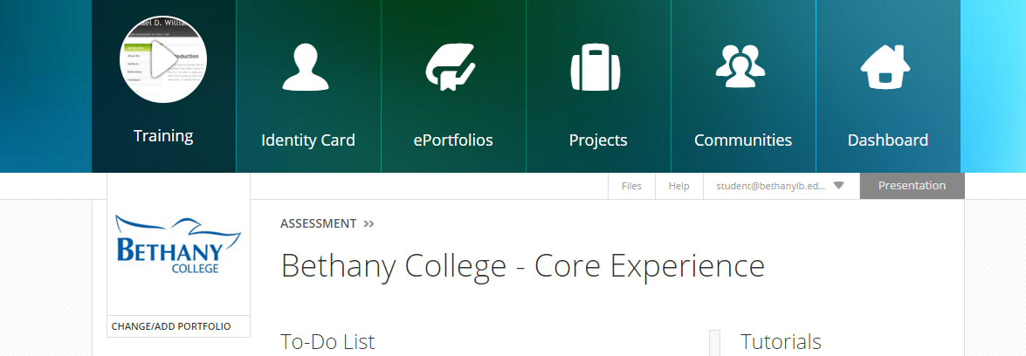
We’ll select ‘ePortfolios’

Slide 7
Once you’re on the ePortfolios screen, click on ‘Create Portfolio’

Slide 8
Choose a theme, and select a template

Slide 9
Choose ‘Blank ePortfolio’ from the list of templates

Slide 10
Then put your name into the box for the name of the portfolio (Click the checkmark to finish)

Slide 11
Now you can begin adding elements Click on ‘Pages’ … then ‘+ Add Page’

Slide 12
Add a page for each of the following
Interdisciplinary Coursework
Bethany Quest
Personal Growth and Accountability
Service and Leadership
Your major(s)
Your minor(s) (if applicable)
Honors Program (if applicable)
Professional Development
Other activities (if applicable)

Slide 13
If you already have some portfolio pages from other courses, select them when adding pages

Slide 14
Rearrange the page navigation here Also, if you add extra sub-pages, nest them here

Slide 15
When your pages are in place, close the menu

Slide 16
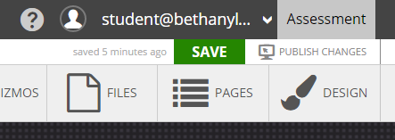
Remember to save your work … early and often!!

Slide 17
Now add content to each page

Slide 18
If you have already loaded files into Foliotek, you can add those to your portfolio using ‘Files’

Slide 19
Otherwise, use ‘Gizmos’ to add files from your google drive, add a link, etc.

Slide 20
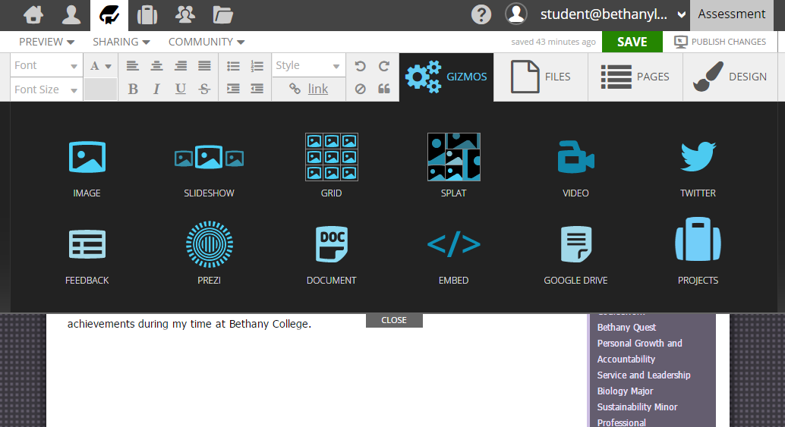
The ‘Gizmos’ menu allows you to choose an item…

Slide 21
… and click to place it in the portfolio

Slide 22
If you wish to add a photo, you can upload from your drive

Slide 23
Use image controls to add a frame, margin, etc., and then drag the photo where you want it

Slide 24
When you have the content of a page the way you want it, move on to the next page

Slide 25
If you added pages from another portfolio, you will get this message when you edit them
Click OK to edit your pages while still in this portfolio
If you’d rather edit your pages in the original portfolio, click on Cancel
Then go to the original portfolio to make any changes to the pages you copied

Slide 26
For individual courses, or for items you wish to group together, try using a ‘Project’ gizmo

Slide 27
You will be prompted to create a new project Name the project; then click on the arrow to get started

Slide 28
Foliotek will automatically begin a tutorial about how projects work

Slide 29
Go through the tutorial, and then start adding content

Slide 30
When you’re ready, share your portfolio in the community for your Quest V section

Slide 31
Enter the invite code provided by your instructor This will be for your Quest V section only

Slide 32
After you join the community, click to select it, and then click on the checkmark

Slide 33
To view the community, click the navigation icon Then click on the ‘View this community’ icon
This will open a new window in your browser

Slide 34
You will be able to view the ePortfolios of the other students in your section

Slide 35
You can also send a message to someone about their ePortfolio

Slide 36
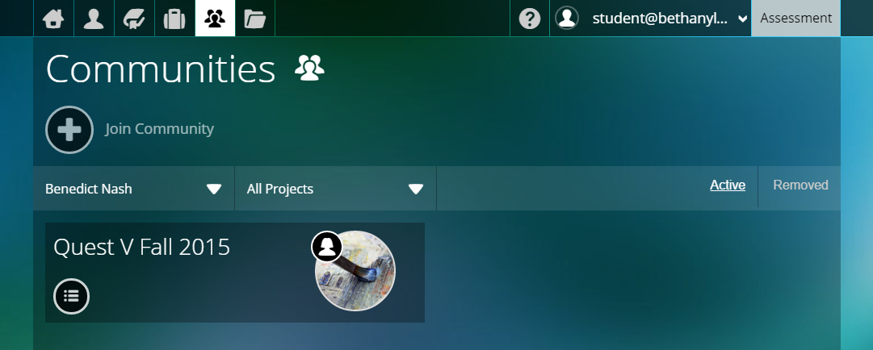
To get back to the previous screen, select the appropriate window tab in your browser
To get back to your portfolio, click on the book icon

Slide 37
To continue working on your portfolio, click on the pencil icon

Slide 38
Any time you make changes to your ePortfolio, click to save, and also be sure to ‘publish changes’
If you do not publish changes, your changes will not be visible by anyone in the community (or anyone you share your portfolio with)

